Slide 1
Diploma In Packaging Technology
Packaging Machinery

Slide 2
Overview
Packaging line machinery:
Beginning: Handling, preparation
Middle: filling, closing
End: labelling, coding, 2nd packaging, palletising

Slide 3
Packaging Supply
Quantity
Quality
Damage & error free
Traceability

Slide 4
Handling
Automatic or manual
Consider size weight and uniformity of product
Damage free
Careful handling and storage
Environmental, handling, storage,
Board, film, containers, closures

Slide 5
Conveying
Damage
Blockage
138 PHS300 Fully Auto Bulk Depalletizer by www.phsinnovate.com (youtube.com)
Vibratory Bowl & Linear feeder.wmv (youtube.com)

Slide 6
Inspection & Cleaning
Cleaning
Washing & Drying, air cleaning, sterilization
Inspection
Manual or Automatic

Slide 7
Filling Equipment
Product Characteristics
Metering of product

Slide 8
Capping & Closing
Capping & Closing
Crown cap, screw, induction heat seal, push on, ROPP, can seal
Orientation important therefore sorter important
Heat Sealing
Adhesive
Hot melts, self adhesive, starch, casein cold seal

Slide 9
Form Fill Seal
Packs formed at point of packaging
Vertical form fill seal
Horizontal form fill seal (flow wrapper)
Sachet forming
Thermoforming fill seal

Slide 10
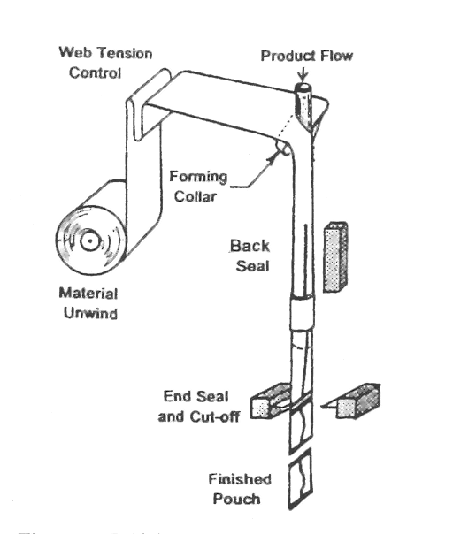
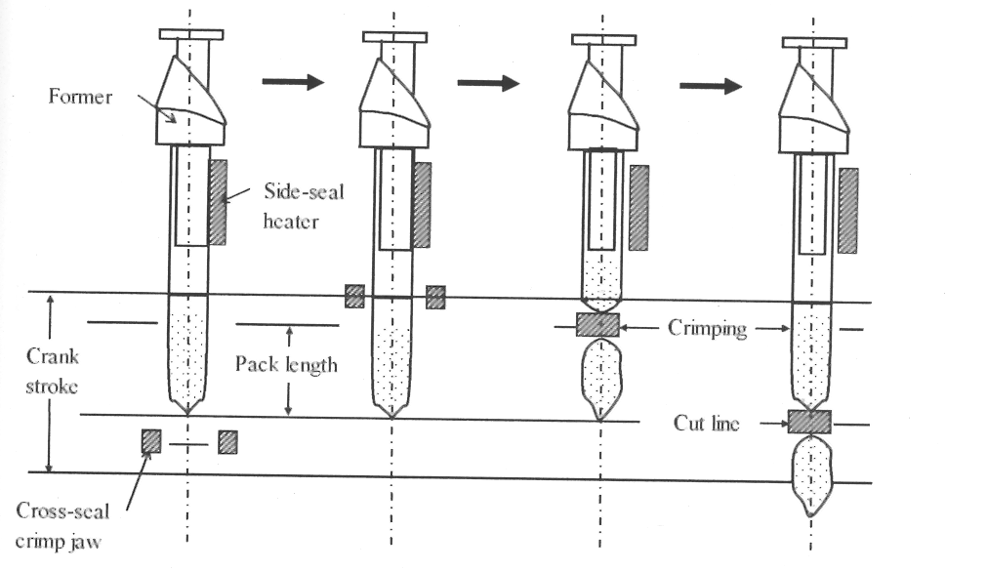
Vertical Form Fill Seal

Slide 11
VFFS C95e + Double square bottom/top forming unit (single fold) + volumetric cup filler GDV60 - YouTube

Slide 12
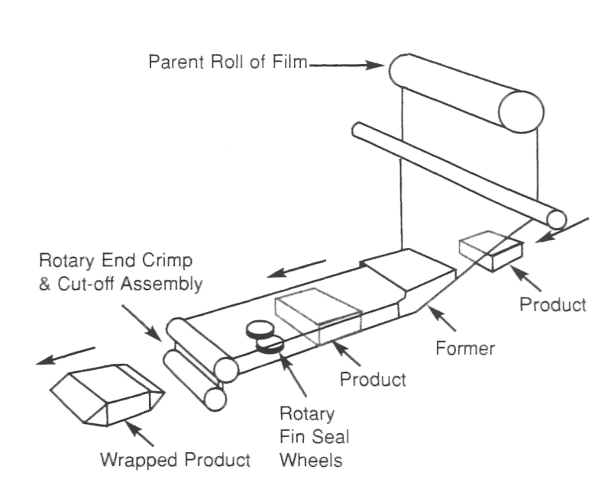
Horizontal Form Fill Seal
https://www.youtube.com/watch?v=1jnKSzZRaxc
Doboy-Bosch Pack 101 Horizontal Flow Wrapper Demonstration (youtube.com)

Slide 13
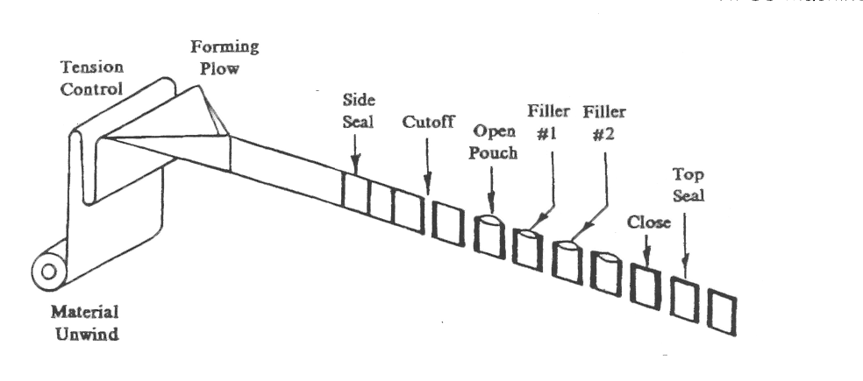
Sachet Forming
UltraClean Spouted Pouch FFS packaging machine LMS 124 (youtube.com)

Slide 14
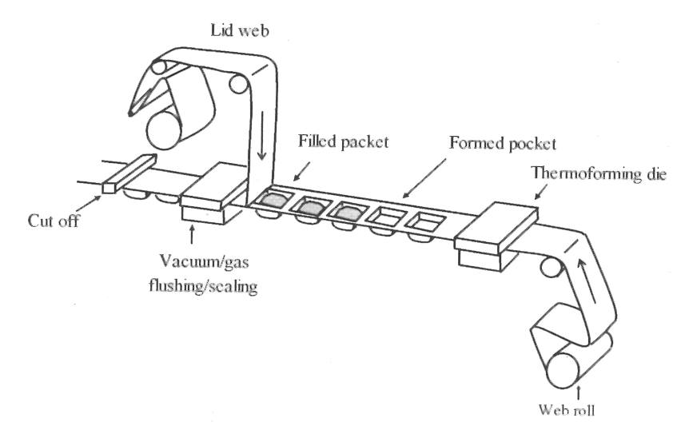
Thermoform Fill Seal – Tray Seal
https://www.youtube.com/watch?v=O7bkAlAD-a4
Flat Plate Blister Packing Machine - ALBLIS-II with Coated Tablets Feeding (youtube.com)

Slide 15
Form Fill Seal
Heat Seals : Triangle
Material properties : Tensile, COEF

Slide 16
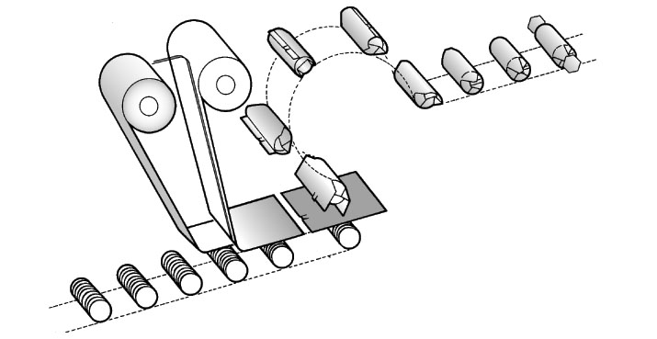
Roll Wrap

Slide 17
Carton Filling
Automatic / manual erection
Horizontal or vertical filling
Carton sealing
Cartoning machine: automatic box packing machine, carton erecting, filling and sealing machine (youtube.com)
Glass bottles case packer Cermex FlexiPack | Sidel (youtube.com)
WRAPAROUND CASE PACKER - 2021 - YouTube

Slide 18
Post Filling Operations

